Slide 1
Instagram user analytics

Slide 2
Mareketing analysis
1. From question no.1 we can identify the 5 oldest users of instagram.
2. From question no.2 we can identify the users who have active id but have’t posted any photos on the platform.
3. From question no.3 we can determine the winner of the contest of users having most numbers of likes in their photos posted on the platform.
4. From question no.4 we can identify the top five most commonly used hashtags on the platform.
5. From question no.5 we can identify which day in the week maximum users get registered on the platform ,so by knowing this company can schedule their ad campaigns relevantly.

Slide 3
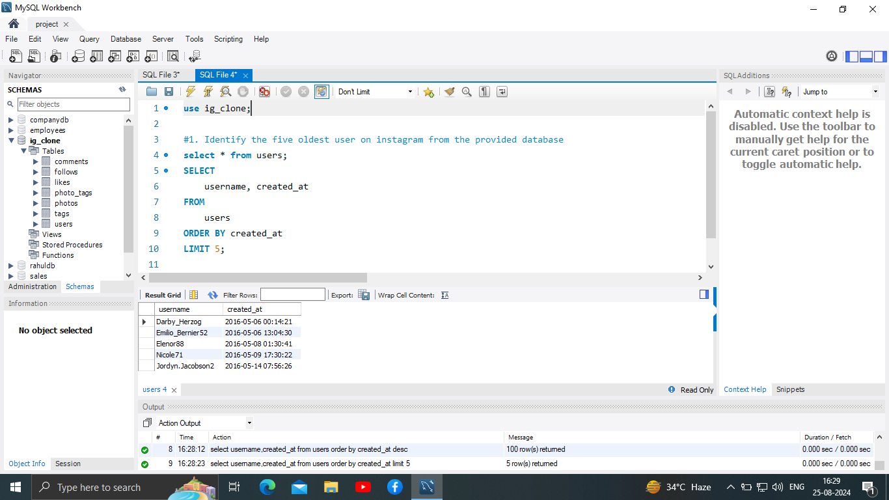

Slide 4
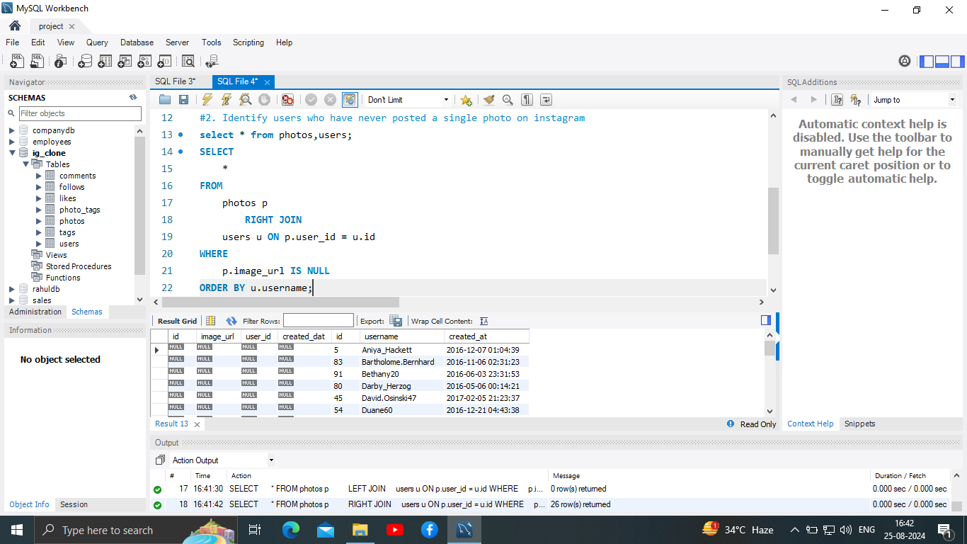

Slide 5
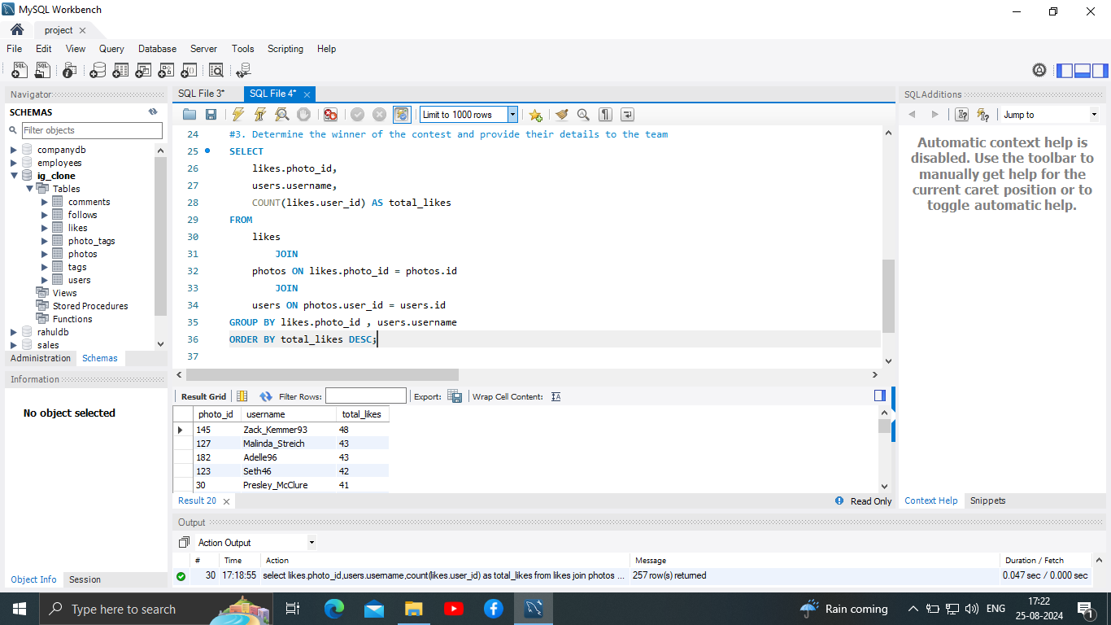

Slide 6
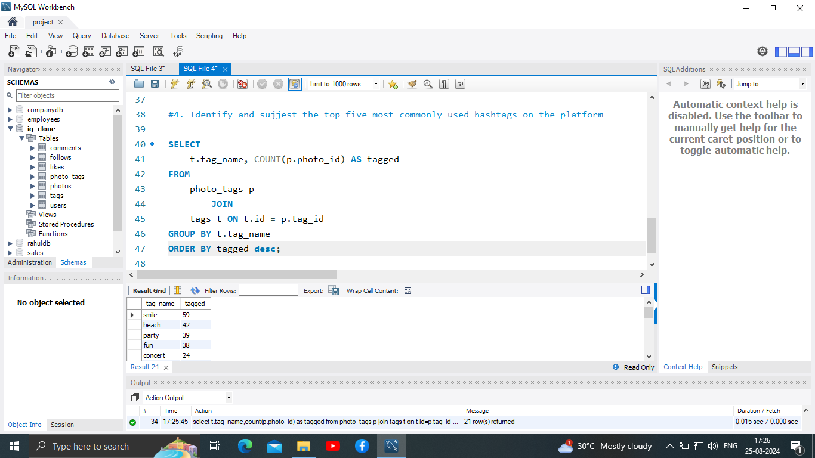

Slide 7
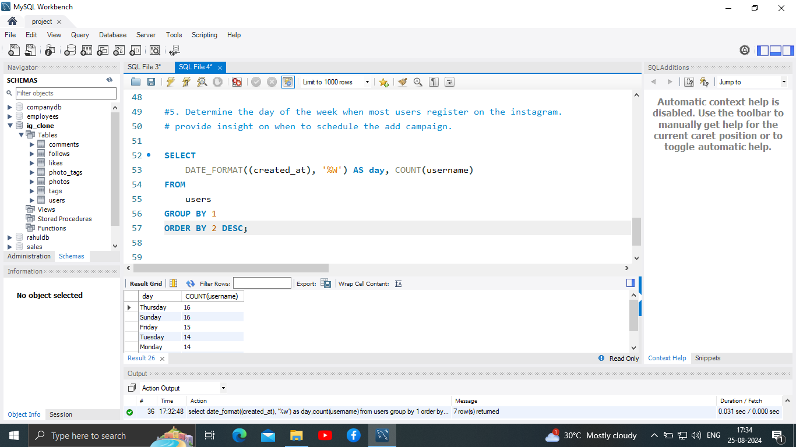

Slide 8
Investor metrics
1. From question no.1 we can identify the total number of users on instagram and their posts of the platyform ,so the investor can make relevant descision on how can a investor make their profit from the platform.
2. From question no.2 we can identify any bots or fake accounts in the platform,which can later help investor to make their investing descision.

Slide 9
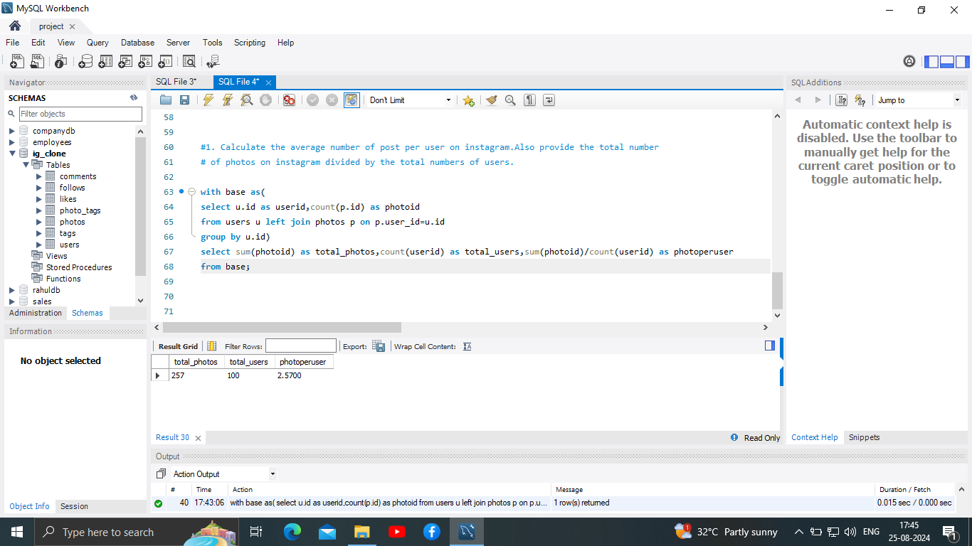

Slide 10
